Slide 1
Artificial intelligence activities and ethical approaches in leading listed companies in the Eurozone
Banco de España. Madrid, September 24 & 25 2020
Enrique Bonsón. University of Huelva
Domenica Lavorato. University of Naples “Parthenope”
Rita Lamboglia. University of Naples “Parthenope”
Daniela Mancini. University of Teramo

Slide 2
Research agenda
Motivations
Research questions
Background
Hypotheses
Research design and methodology
Findings and results
Conclusion

Slide 3
Motivations
The growing popularity of artificial intelligence (AI) raises important questions about the extent to which it affects businesses, consumers and the economy in more general terms.
From the firm's perspective, the adoption of AI generates new benefits, possibly leading to a substantial increase in labor productivity, efficiency, and new revenue streams.
At the same time, the development, deployment, and use of AI systems imply several risks and ethical challenges due to their impact on human rights, privacy, employment, and other social issues.
In the last few years, the European Union (EU) and various European countries have been encouraging and regulating AI innovation. Furthermore, companies have begun disclosing information regarding their AI initiatives. However, in Europe, AI disclosure is voluntary; hence, whether to disclose and to what extent, and the type of disclosed information are almost entirely left to the discretion of companies.

Slide 4
Research questions
RQ1: Are companies listed in the Eurozone disclosing information about AI?
RQ2: Are they using AI systems?
RQ3: Are they developing or following ethical guidelines for AI?
RQ4: What are the factors associated with AI activity or ethical approaches to AI?

Slide 5
Institutional context: AI discourse in the EU
European Commission (2018).
Ethics Guidelines fo Trustworthy AI. High-Level Expert group on Artificial Intelligence

Slide 6
Legitimacy theory and disclosure
Using the lens of legitimacy theory the study explores information about AI activities and ethical principles that companies listed in the Eurozone include in their annual and/or sustainability reports and investigates what factors could explain these practices.
Legitimacy theory provides a robust interpretation of corporate behavior in aligning to society norms, beliefs, and values, and in gaining social acceptance from stakeholders. To exploit their legitimacy strategy, companies should voluntarily report financial and non-financial information, in line with the expectations of society.
However, the literature (e.g. Campbell et al., 2003; De Villers and Van Staden, 2006; Bonsón and Flores, 2011; Bonsón and Bednárová, 2013; Hahn and Kuhnen, 2013; Solikhah, 2016; Lamboglia et al., 2018; Nielsen and Thomsen, 2018) mainly focuses on the role of legitimacy in non-financial information such as Corporate Social Responsibility (CSR), but largely ignores AI discourse.

Slide 7
AI and ethics
Due to the controversial role of AI and its nature as an emerging technology, characterized by ‘radical novelty, relatively fast growth, coherence, prominent impact, uncertainty, and ambiguity’ (Rotolo et al., 2015), many studies focus on its ethical implications.
Some studies develop general theoretical frameworks of the ethical implications of AI starting from models built for emerging technologies (Munoko et al., 2020; Wright and Schultz, 2018; Wieringa, 2020).
Most existing ethical models of emerging technologies and AI propose a checklist of values or principles in line with the EU Guidelines (Brey, 2012; Munoko et al., 2020).
However, research concerning this topic is still at its infancy, mostly theoretical, and how various theoretical frameworks may be translated into ‘practical implementation of ethics into AI systems’ (Vakkuri and Abrahamsson, 2018) is still unclear.

Slide 8
Hypotheses
Company size. In general, large companies are more likely to disclose non-financial information and have a greater social impact. Hence, the disclosure of AI information can be regarded as an instrument to reduce asymmetric information and ensure legitimacy by signalling AI efforts in corporate reports.
Company sector. Companies belonging to Technology and Telecommunications industries are susceptible to AI problems. They typically face greater pressure from stakeholders to develop, deploy, and use trustworthy AI and disclose information about their AI activities.
Region of listing. In Europe, GDP per capita is higher in Northern countries than in Southern economies. Furthermore, according to recent studies and economic forecasts (Pwc, 2017), the impact of AI on GDP varies across regions. In Europe, it is expected to vary between Southern and Northern countries. In particular, rich countries are supposed to invest more in AI activities.

Slide 9
Research design and methodology

Slide 10
Research design and methodology I
We downloaded the 2018 annual reports of companies listed in the following European market indexes: CAC 40, DAX 30, IBEX 35, MIB 40, OMX HELSINKI 25, OMX STOCKHOLM 30. Sample: 200 companies.
Within each report we searched all the mentions for the words “artificial intelligence”, “machine learning”, “deep learning” and “big data”.
We classified each mention according to the following categories: general statement, project, product/application, ethics, risk, unit/lab.

Slide 11
AI disclosure taxonomy
Category | Description
General statement | Sentences with generic content, referring for example to the context in which the company operates or the spread of new technologies, not providing any specific information regarding AI development, deployment and use.
Project | Specific projects, developed or under development, related to AI
Unit | Specif organisational unit responsible for developing, deploying and managing AI systems employment
Product/application | Specific AI applications (example chatbot, etc.)
Ethics | AI ethical principles

Slide 12
Research design and methodology II
Companies were then considered active (if they report some projects, products or units), or no active (no report or just general statements on AI).
We also identified companies with ethical principles.
Once the dependent variables were collected (activity, ethics) we identified potential explanatory factors, namely: the size of the Company (revenue), the sector in which it operates and the region of the stock market were it is listed .

Slide 13
Variables
Variables | Name | Description | Score
Dependent | Activity | Company reports information classified as project, product or unit | Dummy variable (if Company is active=1, if not=0)
 | Ethics | Company declares to develop or use ethical principles on AI in the annual report and/or sustainability report | Dummy variable (if Company develops AI ethical principles=1; if not=0)
Independent | Company sector | Company sector as indicated in the Listed Market, grouped according its theoretical implications for AI development in term of technology and telecommunication | Dummy variable (if Company belong to technology or telecommunication sector=1; if not=0)
 | Region of listing | Regional European area of the Stock Exchange Market in which the company is listed, grouped in northern and southern area. | Dummy variable (if Company is listed in Nordic country=1; if not=0)
 | Company size | Company size classified in gig or small according to the amount of revenues | Dummy variable (if Company has more than 10 billions euro of revenue=1; if not=0)

Slide 14
AI disclosure (RQ1)
 | Germany | Finland | Sweden | France | Italy | Spain | Whole sample
No disclosure | 20% | 32% | 33% | 15% | 28% | 20% | 24%
Just general statement | 20% | 24% | 13% | 20% | 10% | 20% | 17,5%
AI disclosure | 60% | 44% | 54% | 65% | 62% | 60% | 58,5%

Slide 15
AI activity disclosure (RQ2)
 | Germany | Finland | Sweden | France | Italy | Spain
Projects | 40% | 24% | 27% | 33% | 43% | 34%
Products | 47% | 36% | 33% | 50% | 40% | 49%
Units | 24% | 4% | 20% | 23% | 23% | 9%

Slide 16
AI ethical approaches (RQ3)
Ibex 35
Telefonica: Artificial Intelligence Principles
DAX 30
Deutsche Telekom: Guidelines for Artificial intelligence
Sap: Guiding Principles fro Artificial Intelligence
OMX Helsinki 25/OMX Stockholms 30
DNA: Ethical Principles for the use of AI
Kesko: Ethical principles for utilizing artificial intelligence
Nokia: European Commision Ethics Guidelines for Trustworthy AI
Sampo: Artificial Intelligence with responsibility
Telia Company: Guiding Principles on trusted AI ethics
Tieto: AI ethics guidelines

Slide 17
AI ethical approaches (RQ3)
 | Deutsche Telekom | DNA | Kesko | Nokia | Sampo | Sap | Telia | Telefónica | Tieto
Human Agency & Oversight | X | X | X | X | X | X | X | X | X
Technical Robustness & Safety | X | X |  | X | X | X | X |  | X
Privacy & Data Governance | X | X | X | X | X | X | implicit | X
Transparency | X | X | X | X | X | X | X | X | X
Diversity, non-discrimination & Fairness | implicit | X | X | X | X | X | X | X | X
Social & Environmental Wellbeing | X |  | X | X |  | X |  | X | X
Accountability | X | implicit | X | X | X | implicit | X | implicit
Continuous Reviewing & Dialogue |  |  | X |  |  |  | X

Slide 18
AI explanatory factors (RQ4)
Table 1- Multivariate statistics – Generalised Linear Model (Binomial)
Independent variable | Dependent variable
 | Activity
 | Estimate | Std.Error | z value | Pr (>│z│)
(Intercept) | -0,1135 | 0,2555 | -0,444 | 0,656829
Sector | 1,6893 | 0,5507 | 3,067 | 0,002159**
Revenue | 1,1927 | 0,3268 | 3,650 | 0,000263***
Region | -1,0034 | 0,3267 | -3,071 | 0,002133**
***Significant at p<0,001
**Significant at p<0,01
Table 2- Multivariate statistics – Generalised Linear Model (Binomial)
Independent variable | Dependent variable
 | Ethics
 | Estimate | Std.Error | z value | Pr (>│z│)
(Intercept) | -6,5724 | 1,2777 | -5,144 | 2,69e-07***
Sector | 4,0653 | 0,8972 | 4,531 | 5,87e-06***
Revenue | 1,2173 | 0,8596 | 1,416 | 0,1567
Region | 1,9054 | 0,8979 | 2,122 | 0,0338*
***Significant at p<0,001
*Significant at p<0,05

Slide 19
Conclusions
Most European companies disclose AI activities to some extent. The study’s findings suggest a growing interest in these technologies, although 41.5% of firms are still not reporting any activity on AI. The adoption of ethical approaches to AI is not widespread (9/200 firms adopt an ethical approach).
The regression analysis results indicate a significant impact of all independent variables on AI activities. The largest companies present a higher level of activity. Companies in the Tech and Teleco sectors are more active. Southern countries' companies are more likely to disclose information on AI activity.
Regarding ethical approaches, the regression analysis indicates a significant impact of region and sector on ethics. The majority of companies developing ethical principles are in the Northern region and belong to the Technology and Telecommunications sectors.

Slide 20
Thanks for your attention!
Corresponding author: Domenica Lavorato
E-mail: domenica.lavorato@uniparthenope.it

Slide 21
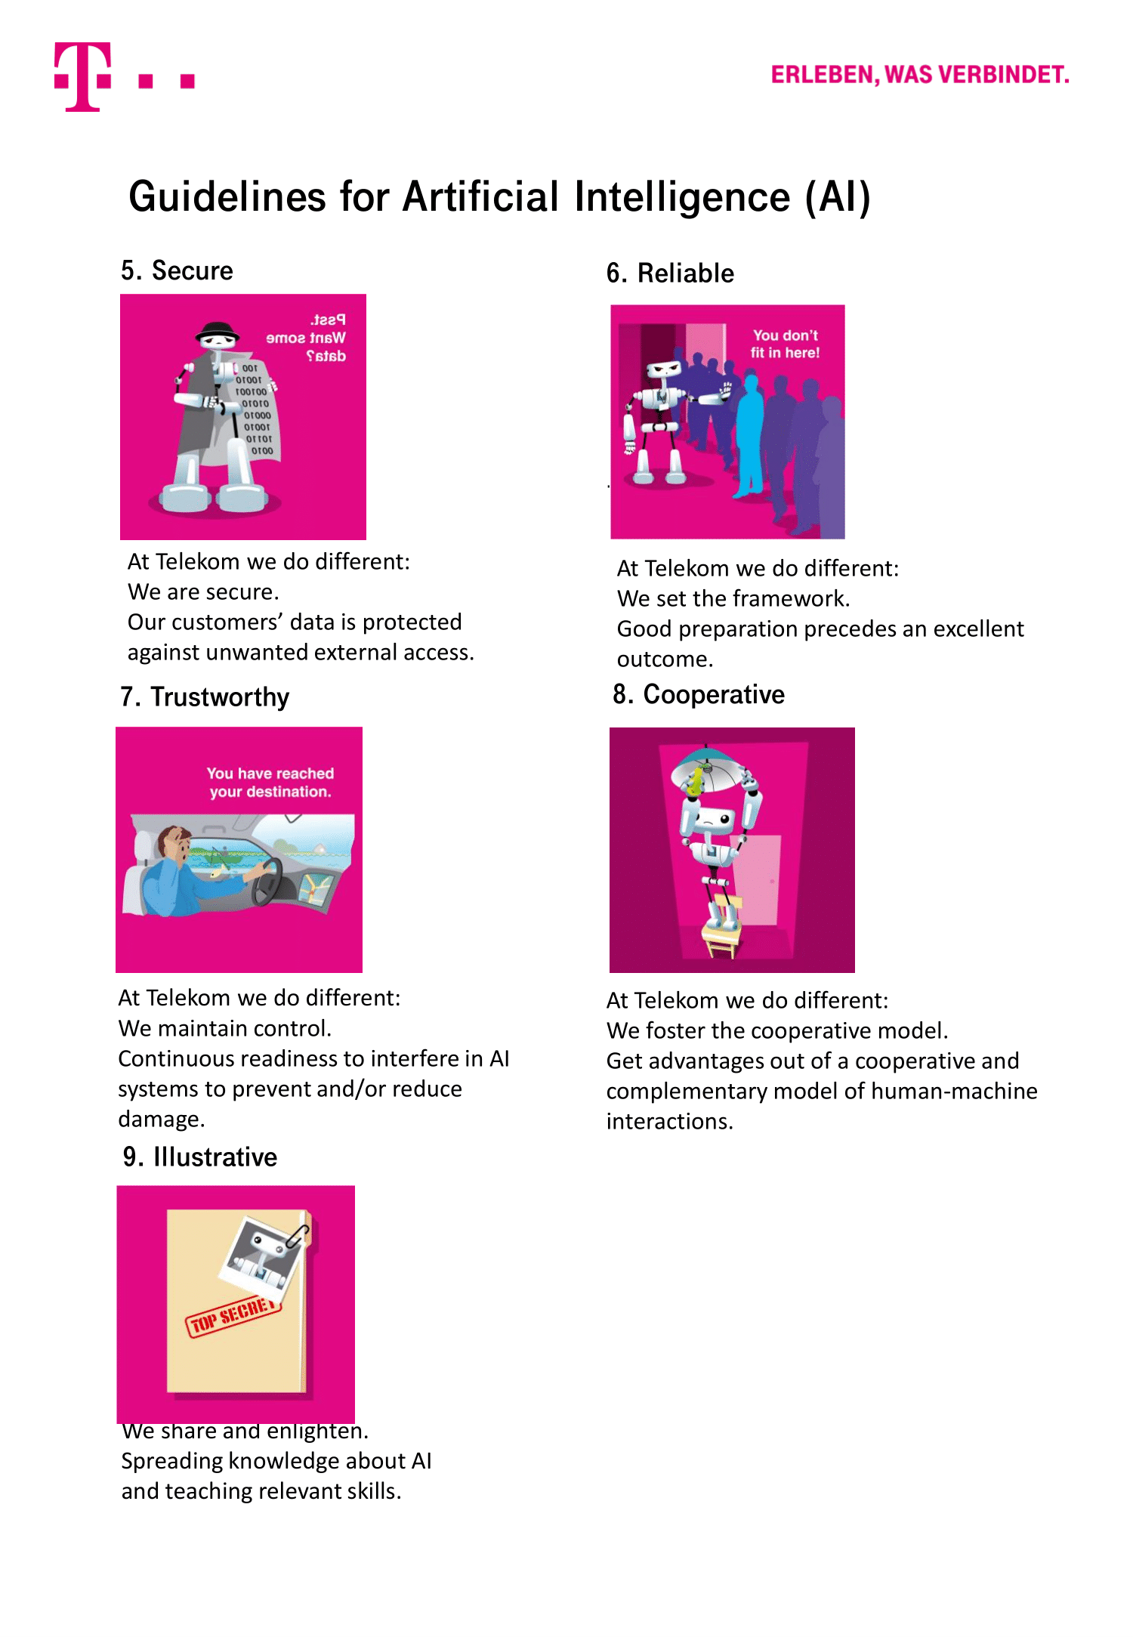
Deutsche Telekom- Guidelines for Artificial Intelligence

Slide 22
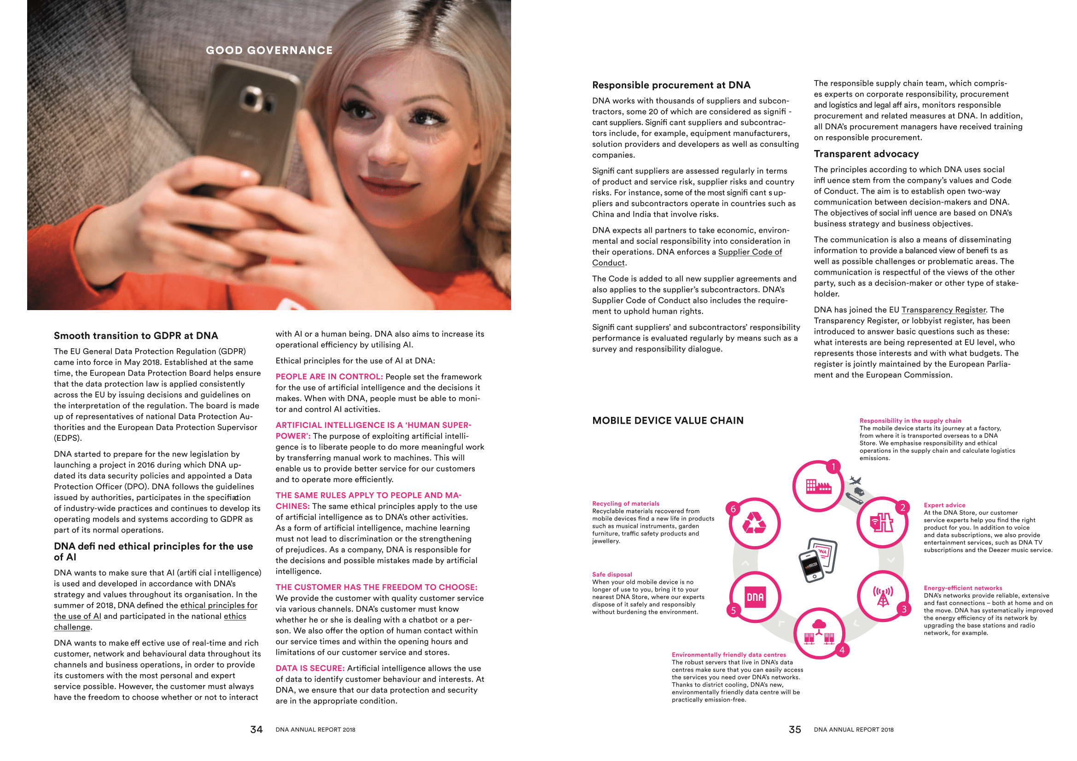
DNA- Ethical Principles for the use of AI

Slide 23
Kesko- Ethical principles for utilizing artificial intelligence

Slide 24
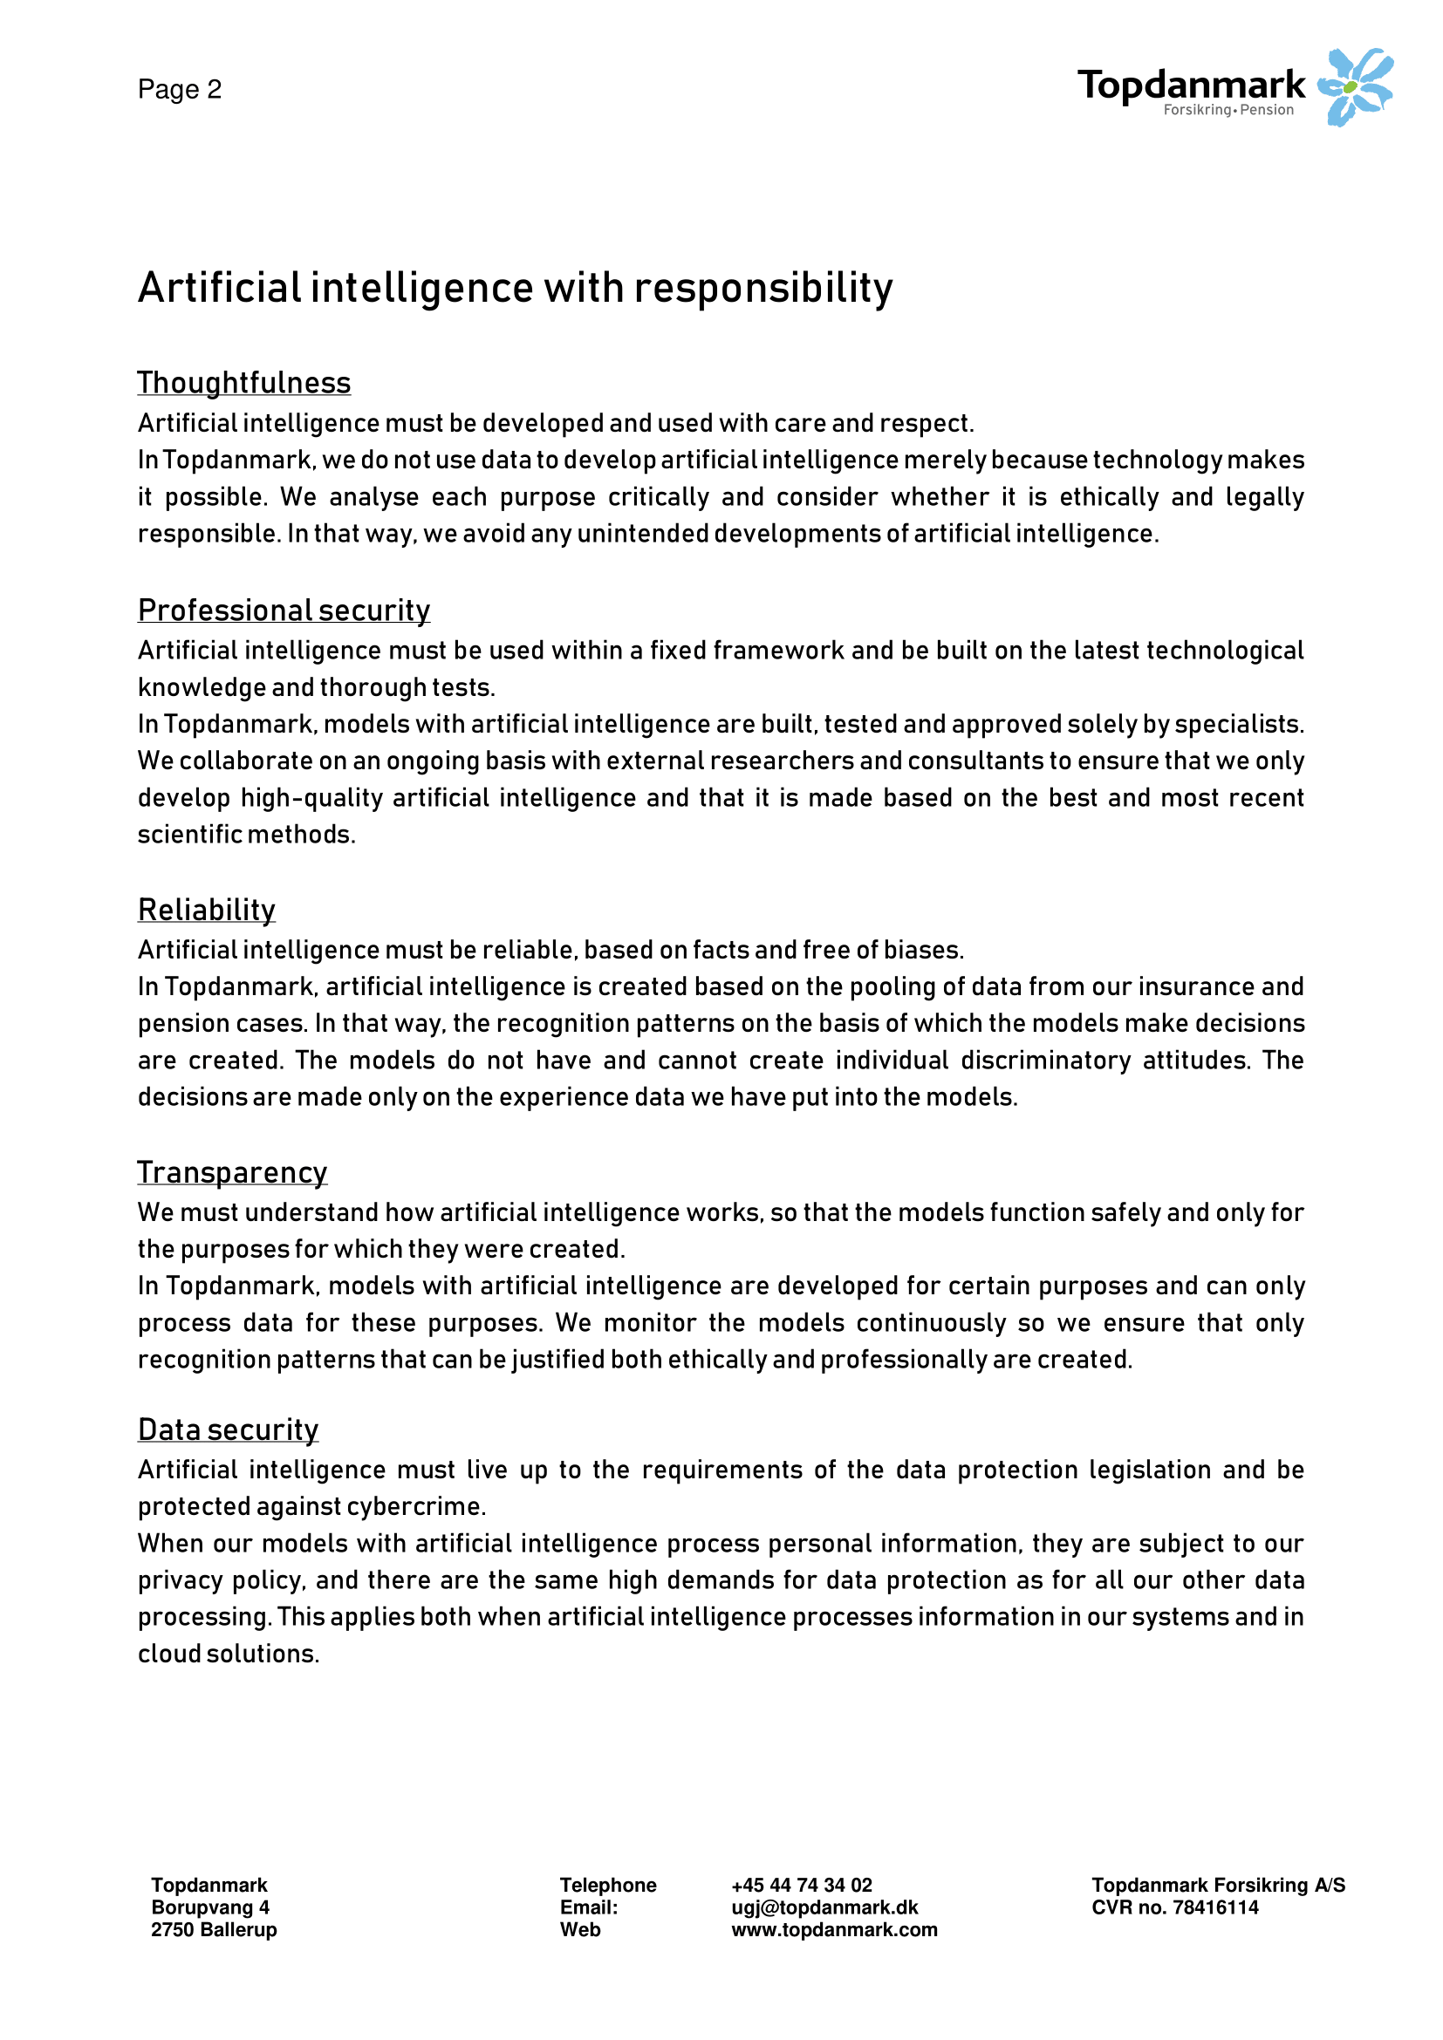
Sampo- Artificial Intelligence with responsibility

Slide 25
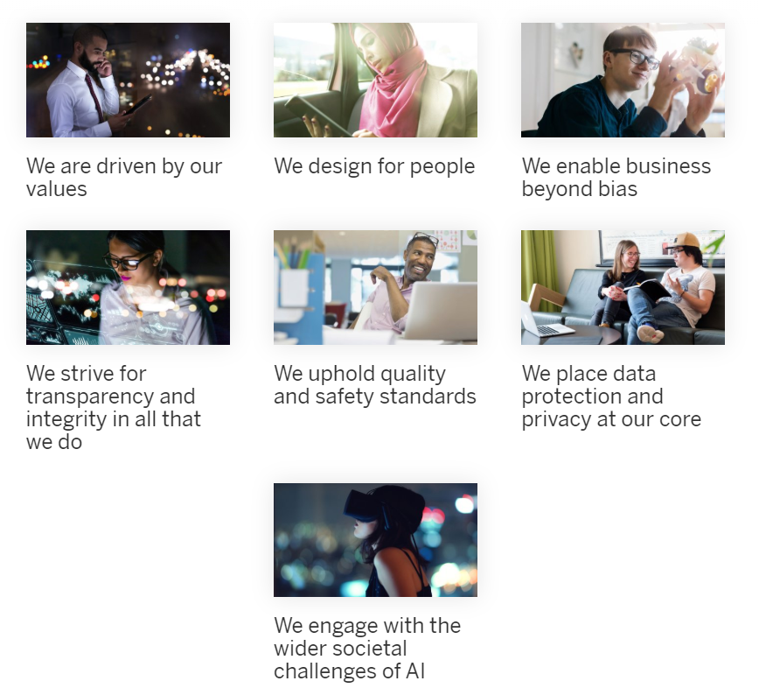
Sap- Guiding Principles for Artificial Intelligence

Slide 26
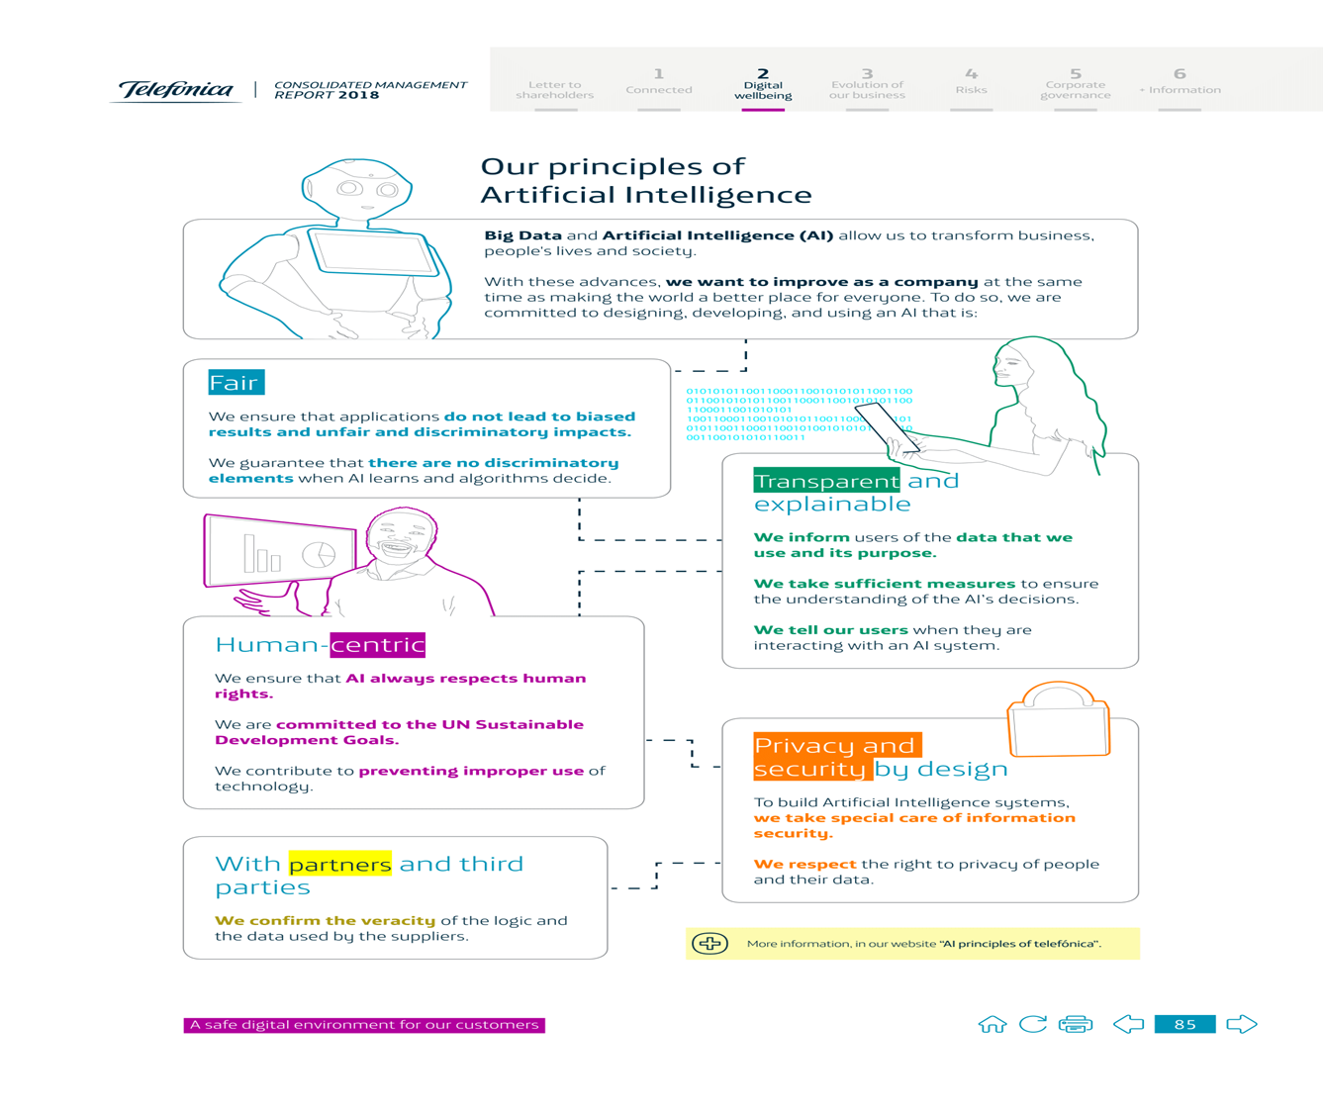
Telefonica- Artificial Intelligence Principles

Slide 27
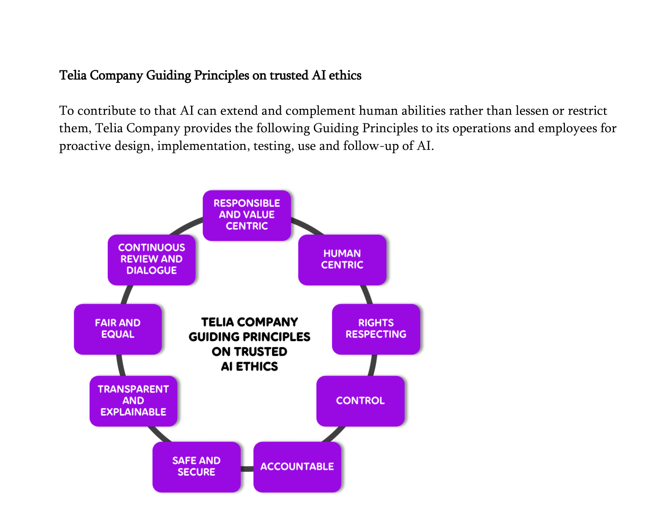
Telia Company- Guiding Principles on trusted AI ethics

Slide 28
Tieto- AI ethics guidlines

